Slide 1
HG VORA Case Study
Submitted by: Mark Hiquiana

Slide 2
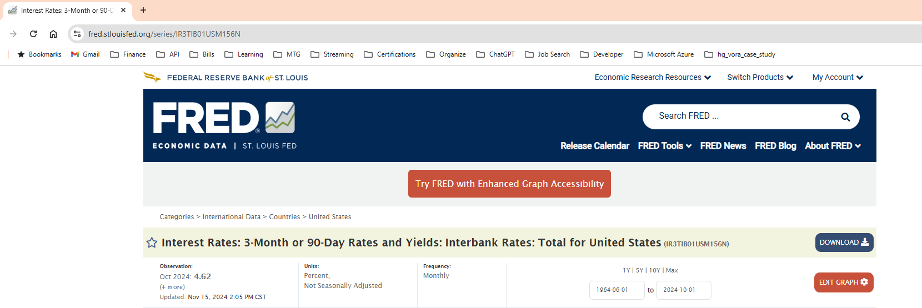
Running the Code
1. Once you have access to main.py you will notice that you are able to assign the variables. The variables can be found at the end of the address bar for the indicator you are looking at see below (circled red). (see README.MD for instructions on running the code)

Slide 3
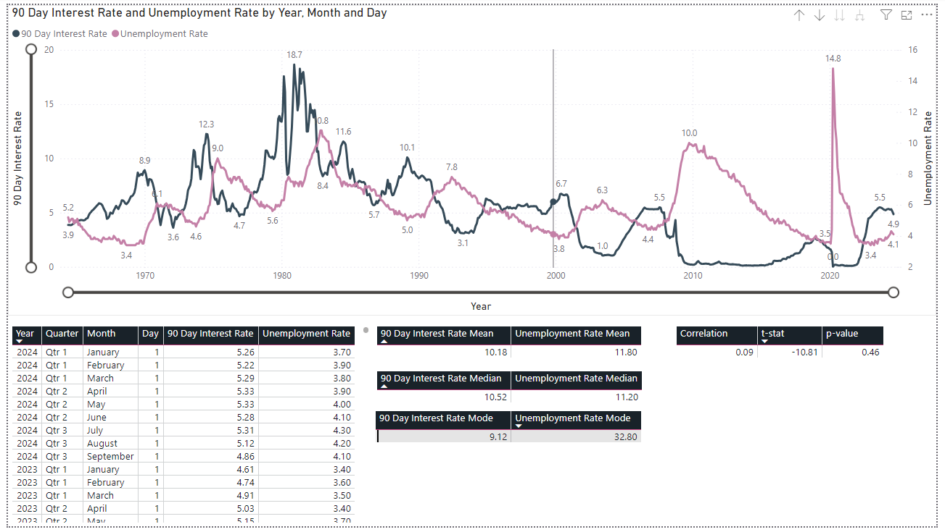
Analysis
Instead of focusing hard on two data points and analyzing them through all current literature I instead created a tool that can take any two economic indicators and run specific statistical test appropriate for most economic indicators available at FRED.
As can be seen in the Power BI Dashboard I used some common statistical test such as t-test, p-value, and correlation coefficient.

Slide 4

Findings 90 Day Interest Rate and Unemployment Rate
t-stat: -5.41 Conclusion: Not significantly different than average P-Value: .23
Conclusion: There is no significant difference between the two groups.
Correlation: .04
Conclusion: positive association

Slide 5
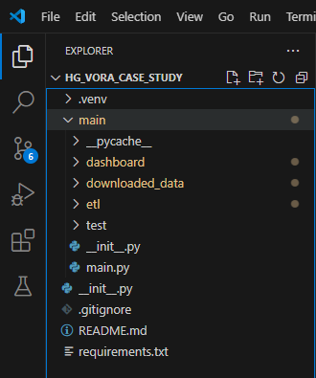
Code Design
For the code design I tried to be pragmatic and act as if this code would be productionized.
As can be seen on the left everything is organized by folder and each piece of code was written in a different script to keep things separated and easier to maintain.
I’ve also included a main.py as the main script to run to use the tool.

Slide 6
Scalability and Maintenance
Quick Note: because this project could have been improved upon in many aspects, I’ve broken it down by each part I felt could have been a project on its own.
Data Extraction
I could have created a scheduler to download the data automatically based on when I expect FRED data to update.
Data Transformations
Instead of doing these in python I think it would have been better to do them in the dashboard so they could calculate when making data selections in or adding parameters in the dashboard.
Data Load
As of now I only use csv files but depending on environment I think it would be better to create historical or versioning control of the data loads e.g. if this was going to a cloud storage like s3 I most likely would have converted this to parquet files.
Dashboard
As iterated above I believe a lot of the calculations should have been done within the dashboard so they can calculate when parameters are changed or updated.

Slide 7
FIN: Questions?

